Slide 1


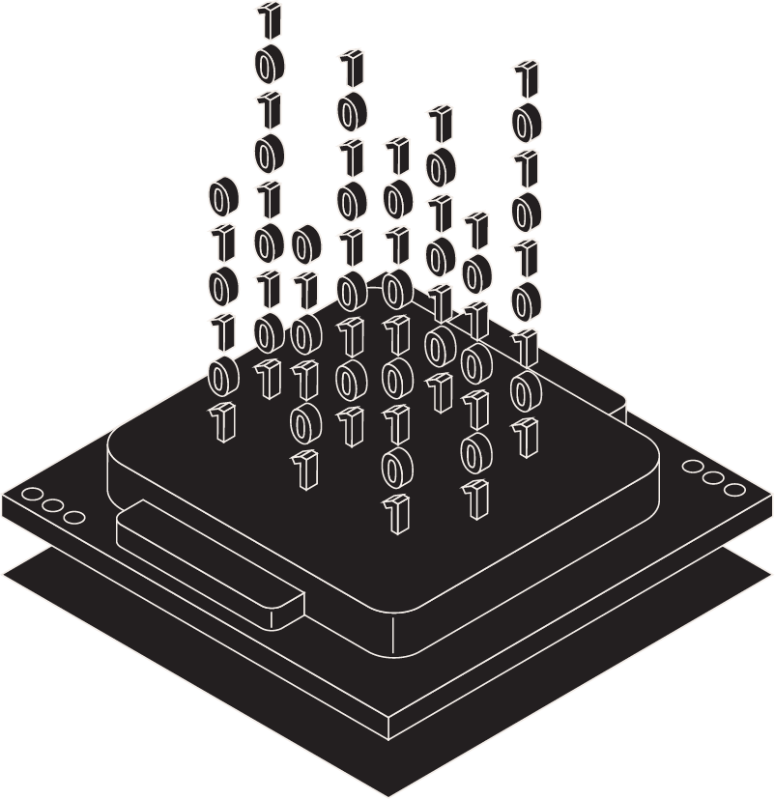
Data Science for Agentic AI
Jade, Alfredo, Monique, Morgan, Emmanuel
10-July-2025

Slide 2
What is Agentic AI?
AI systems that can think, plan, and act autonomously
Built on top of large language models (LLMs) and other advanced architectures
Integrates memory, tool use, and decision-making for dynamic behavior
Examples include:
AI personal assistants
Automated trading agents
Autonomous robotic systems
Notes:
What makes these systems “agentic” is their ability to:
Perceive their environment or context
Reason about what to do
Act toward a goal without constant human oversight

Slide 3
Role of Data Science in Agentic AI
Processes and interprets real-time, contextual data
Enables continuous loops of learning and decision-making
Incorporates feedback from human interaction and environmental input
Ensures data quality, responsible AI use, and performance monitoring

Slide 4
Key Components of Agentic Systems
Data Pipelines: Robust data ingestion and validation processes
Memory & State Management: Maintains long-term context across interactions
Logic & Chain-of-Thought Techniques: Enables structured reasoning and decision-making
Tool Usage: Integrates APIs, external engines, and web tools to take real-world actions

Slide 5
Data Lifecycle in Agentic AI
Ingestion: Captures real-time, multimodal data (text, images, audio, etc.)
Preprocessing: Standardizes inputs through filtering, normalization, and tokenization
Reasoning: Performs dynamic inference and selects appropriate tools or actions
Adaptation: Updates models, memory, or strategies based on outcomes and feedback
Evaluation: Assesses performance using real-world metrics and ethical considerations

Slide 6
Case Study – Agentic AI in Healthcare
System Overview:
A smart care manager agent that supports patient monitoring, coordination, and decision-making.
Standard Machine Learning:
Predicts clinical risks such as hospital readmission or adverse events.
Deep Learning:
Analyzes medical imaging (e.g., X-rays, MRIs) for diagnostics and anomaly detection.
Large Language Models (LLMs):
Extracts insights from clinical notes, guidelines, and unstructured medical text.
Agentic Layer:
Automates patient follow-up, care coordination, and interaction with healthcare tools and systems.

Slide 7
Case Study – Agentic AI in Finance
System Overview:
An independent platform for investment and trading with minimal human oversight.
Traditional Machine Learning:
Forecasts market trends using historical data and statistical models.
Large Language Models (LLMs):
Interprets financial reports, accounting data, and real-time news sentiment.
Agentic Reasoning:
Executes data- and event-driven trading strategies aimed at maximizing profit.
Autonomous Decision-Making:
Makes real-time trading decisions with limited human intervention.

Slide 8
Challenges and Considerations
Data Privacy & Compliance
Adherence to regulations like HIPAA, GDPR, and other data protection standards.
Contextual Accuracy
Ensuring real-time correctness and validity of AI-generated outputs in dynamic environments.
Ethical Alignment
Embedding AI alignment principles and supporting ethical decision-making in autonomous agents.
Managing Hallucinations
Detecting and mitigating inaccurate or fabricated outputs from large language models (LLMs).
Scalability & Resource Constraints
Balancing performance with computational efficiency and infrastructure limitations.

Slide 9
Emerging Trends
Multi-Agent Ecosystems
Agents collaborate, share knowledge, and coordinate tasks across complex environments.
Memory-Enhanced LLMs
Language models with persistent memory for improved contextual understanding and continuity.
Toolformer & API-Compatible Agents
Agents that autonomously decide when and how to use external tools, APIs, and services.
Human-AI Collaboration & Explainability
Transparent decision-making that fosters trust and enables effective human-AI teamwork.
RLHF & Continuous Learning Loops
Reinforcement Learning from Human Feedback (RLHF) and adaptive feedback cycles for ongoing improvement.

Slide 10
DEMO
HCLTech and MIT ‘NANDA’ Decentralizing Agentic AI

Slide 11
Summary
Agentic AI enhances traditional AI systems by enabling autonomous reasoning, decision-making, and action through real-time data processing and memory integration. Built on foundations like LLMs, machine learning, and deep learning, these agents interact with tools, adapt to feedback, and operate across diverse domains such as healthcare, finance, and beyond. Their effectiveness depends on high-quality, ethical data and scalable, explainable architectures. As these systems evolve, they promise more collaborative, intelligent, and responsible AI ecosystems.

Slide 12
References
• OpenAI, Google DeepMind, & Microsoft Research. (2023–2025). Research publications and advancements in artificial intelligence. Retrieved from https://openai.com
• arXiv. (n.d.). Open-access archive for scholarly articles in AI and related fields. Retrieved from https://arxiv.org
• Hugging Face. (n.d.). Open-source machine learning tools and model hub. Retrieved from https://huggingface.co

